Slide 1
Statistical Analysis of Diabetes in Population
Pablo Alfaro
David Carrascosa
Camilo Mercado

Slide 2



Research Questions
Key factors that correlate with diabetes, prediabetes, and no diabetes?
Does physical activity significantly reduce the likelihood of having diabetes?
How does age, income, and education level relate to diabetes prevalence?
Can we predict the likelihood of having diabetes using logistic regression models?
Differences in health outcomes between diabetic and non-diabetic individuals?
Inequality in healthcare access for people with diabetes across income levels?

Slide 3

Our Stakeholders
Public Health Organization
Healthcare Providers
Policy makers

Slide 4
Dataset Structure
Diabetes Status | Body Mass Index | Days of Poor Mental Health | Age Group
0: No diabetes |  | 12 | 18-24
1: Prediabetes |  | 27 | 60-64
2: Diabetes |  | 3 | 80+

Slide 5

Analysis
Load & Explore Dataset
Descriptive Statistics & EDA
Hypothesis Testing
Logistic Regression
Clustering
Inequality Analysis (GINI)

Slide 6
Load & Explore Dataset

Slide 7

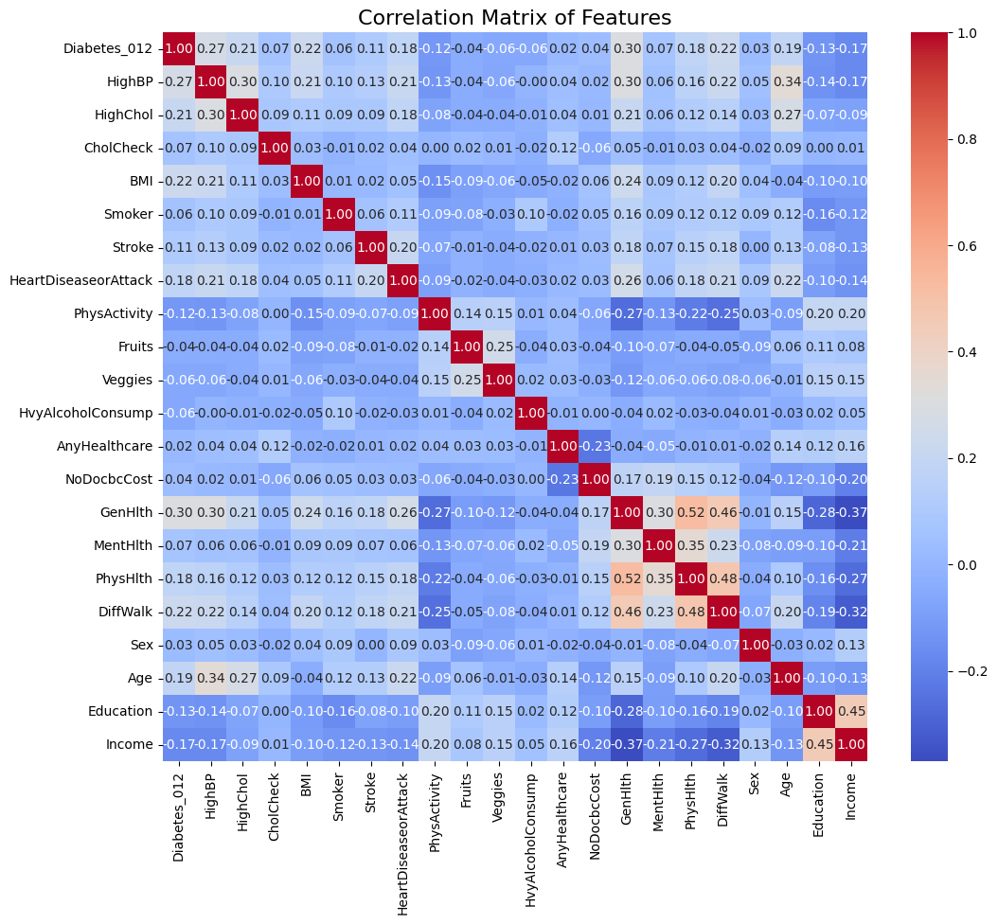
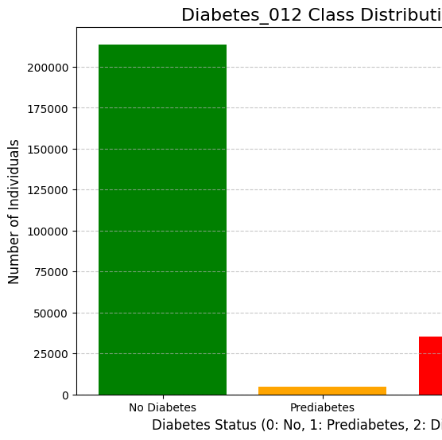

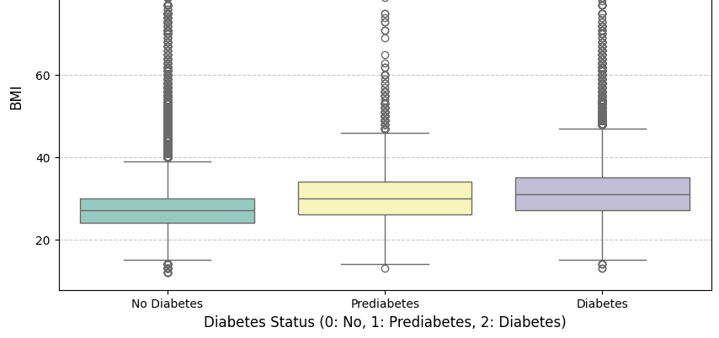
Descriptive Statistics & EDA
WITH OUTLIERS

Slide 8
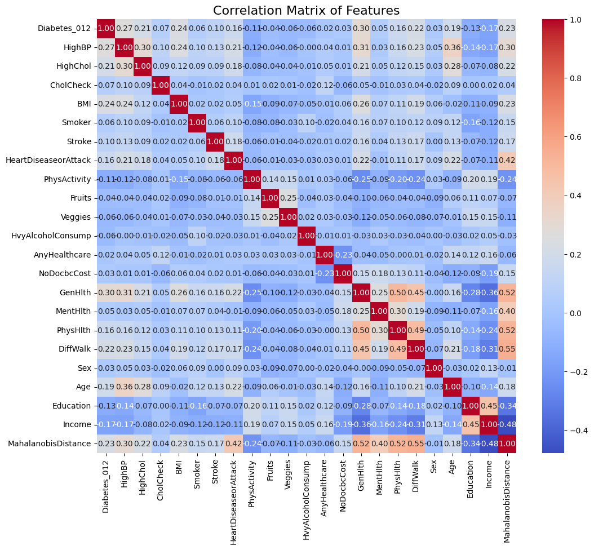

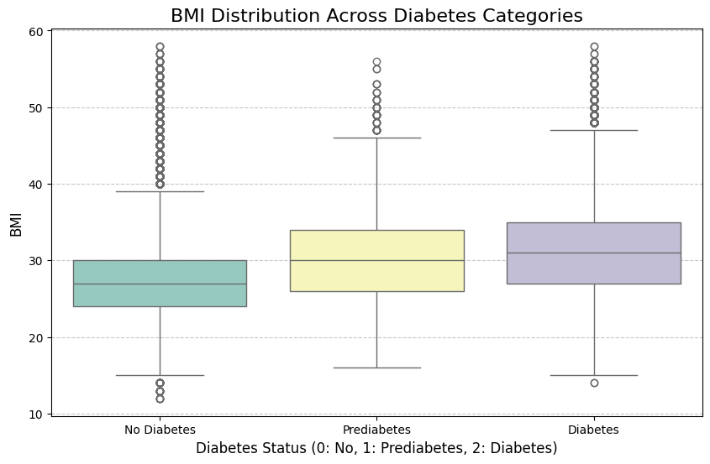
Descriptive Statistics & EDA
WITHOUT OUTLIERS

Slide 9
Hypothesis Testing

Slide 10
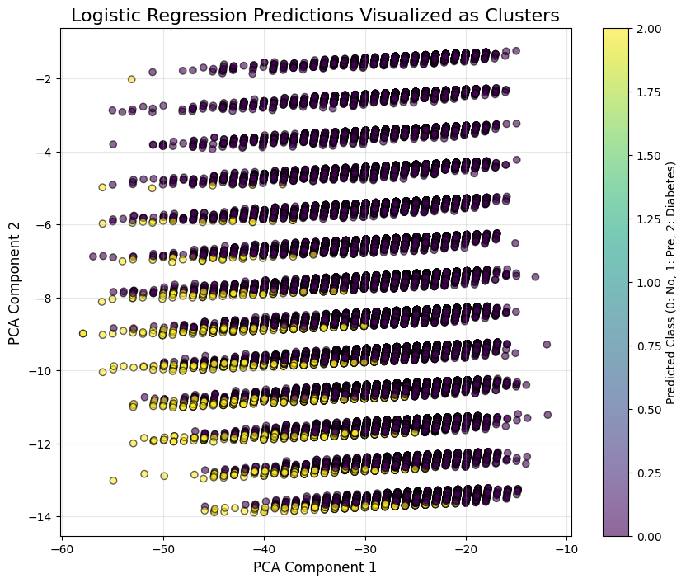
Logistic Regression

Slide 11
Clustering

Slide 12
Inequality Analysis

Slide 13
Conclusion

Slide 14

Thank you!

